Slide 1
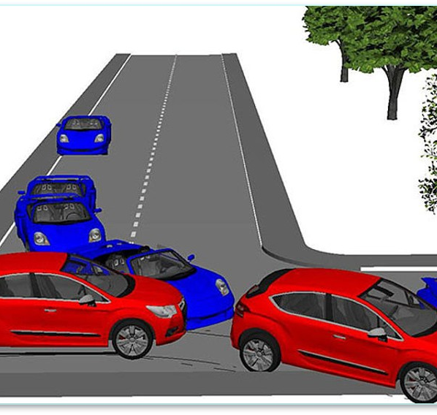
Road Accidents Data Analysis
An analytical overview on road accidents

Slide 2
I. Introduction
This project explores the Road Accident dataset to uncover patterns in urban mobility. The dataset includes detailed records of Road Accident and causalities, road & Weather condition, and other affecting factors.
In this project, we analyse this dataset using Python libraries such as Pandas, NumPy, and Matplotlib/Seaborn.
Objectives:
  Explore dataset structure
  Perform cleaning and pre-processing
  Generate insights from data
  Visualize important trends

Slide 3
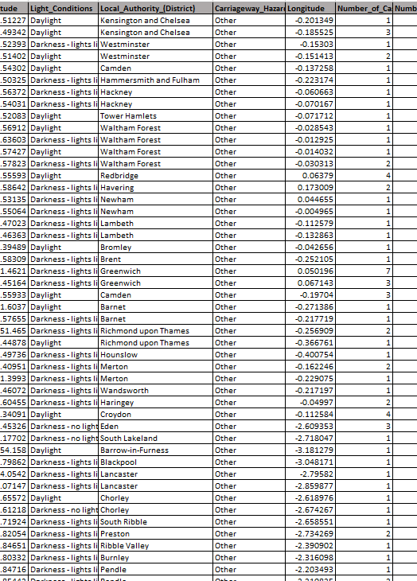
II. Dataset Description
Data is an important source of information in any kind of project as it allows the analyst to build relationships between what is happening in different measures and categories.
Details:
  Total Rows: 307973
  Total Columns: 21
  Data Format: CSV
  Number of Files: 1

Slide 4
II. Dataset Description
Field Name | Description | Example
Accident_Index | Index Number of the Accident Records | 200901BS70001,200901BS70006
Accident Date | Date when the accident happened | 01-01-2021, 02-01-2021
Day_of_Week | Day of week When the accident happened | Monday, Tuesday
Junction_Control | Type of traffic control at the junction | Auto traffic signal, Give way or uncontrolled
Junction_Detail | Specific layout or type of junction | T-junction, roundabout, crossroad
Accident_Severity | Severity level of the accident | Fatal, Serious, Slight
Latitude | Geographic latitude coordinate of the accident location. | 51.512273, 51.493415
Light_Conditions | Lighting at the time of the accident | daylight, darkness with street lights
Local_Authority_(District) | Administrative district responsible for the location. | Kensington and Chelsea
Carriageway_Hazards | Any hazards present on the road | Any animal in carriageway, Other object on road, Previous accident
Longitude | Geographic longitude coordinate of the accident location. | (-0.185525, -0.15303)
Number_of_Casualties | Total number of people injured or killed in the accident. | 1,2,3
Number_of_Vehicles | Number of vehicles involved in the accident. | 1,2,4
Police_Force | Name of the police force that recorded the accident. | Metropolitan Police
Road_Surface_Conditions | Condition of the road surface | Dry, Wet
Road_Type | Classification of the road | Single carriageway, One way street
Speed_limit | Legal speed limit at the accident location | 30, 50, 60
Time | Time of day when the accident occurred | 15:11, 09:34
Urban_or_Rural_Area | Whether the accident occurred in an urban or rural | Urban or Rural
Weather_Conditions | Weather at the time of the accident | Fine no high winds
Vehicle_Type | Type of vehicle(s) involved | Car, Motor cycle

Slide 5
III. Data Cleaning
For data cleaning purposes, we used different techniques based on our scenario which are explained in-depth as follows:
Details:
  1. Checking the Null values
  2. Check for duplicates
  3. Standardize the Data

Slide 6
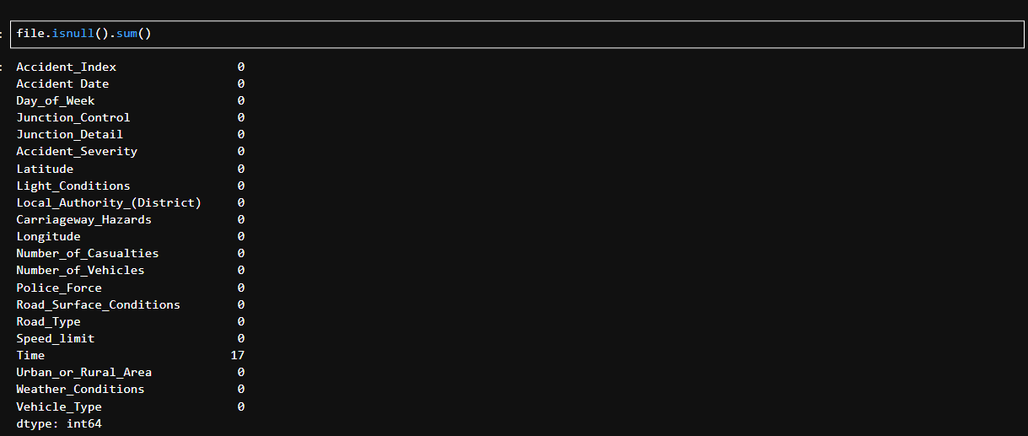
1. Checking the Null values
Found 17 null values in Time Column.
So lets drop those rows

Slide 7
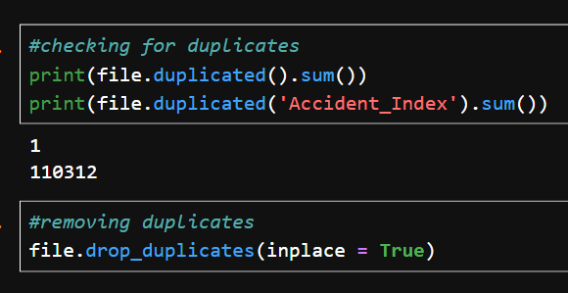
2. Checking the Duplicate values
We have to notice that around 1 lakh of duplicates were found in 'Accident_Index' column, so it is not a unique feature.
And dropped the duplicate rows

Slide 8
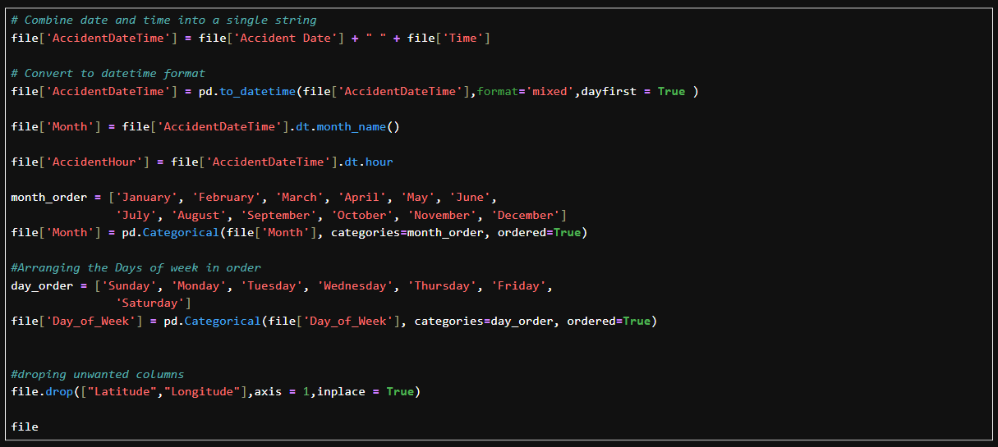
3. Standardize the Data
Combine date and time into a single string
Convert to datetime format
Extracted Month Name and added a new column
Extracted Hour and added a new column
Arranging the Days of week and Months columns in order
Droping unwanted columns

Slide 9
IV. Exploratory Data Analysis
For data analysis purposes, I followed the below steps to analyse the data and provide insights and visualise.
Activities:
  Summary Statistics
  Analysis Visualizations
  Providing Insights

Slide 10
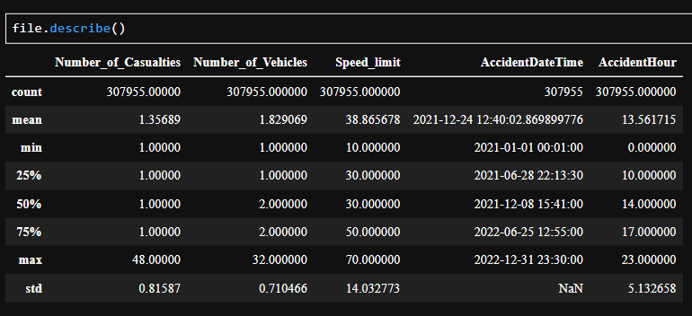
A. Summary Statistics
To know min and max values.
To check is there any outliers
To know the range of distribution

Slide 11
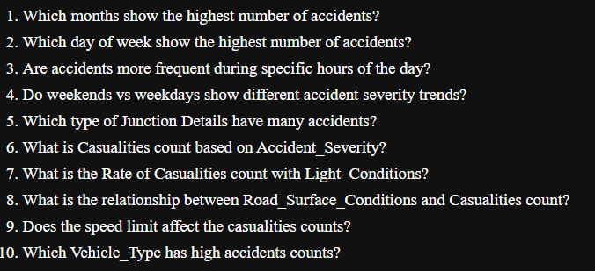
B. Analysis of the Data
To analyse and get insights, framed question
By finding the answer, we can get the insights

Slide 12
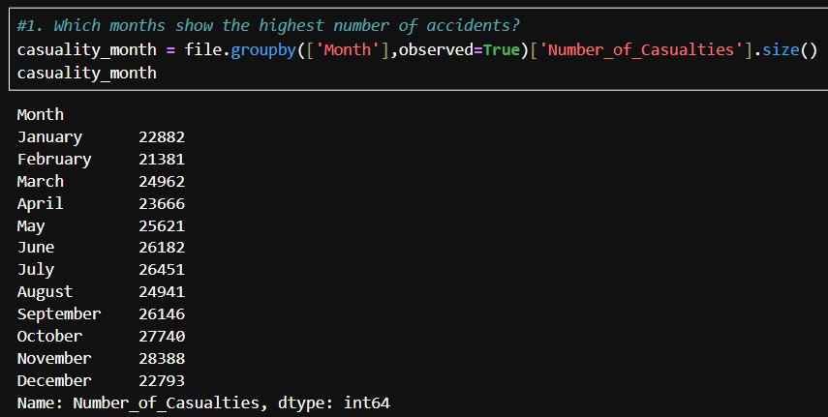
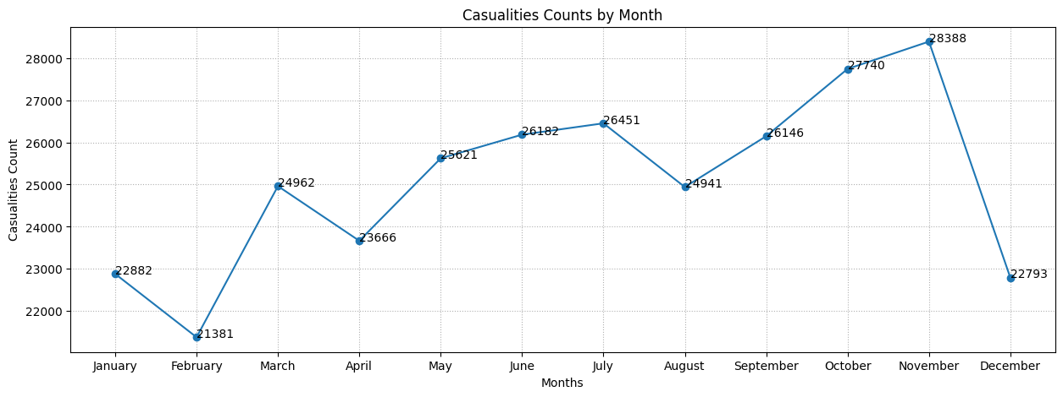
1. Which months show the highest number of accidents?
The most accidents was happened on November(29094).
Least accident was occurred in February(21882)

Slide 13
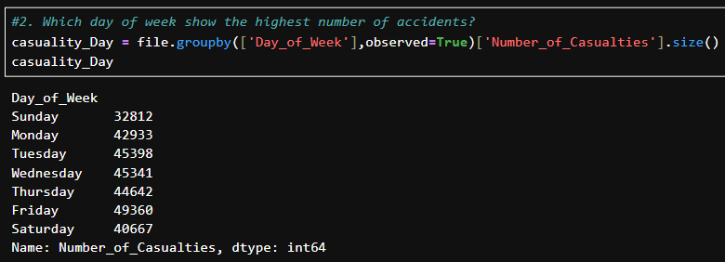
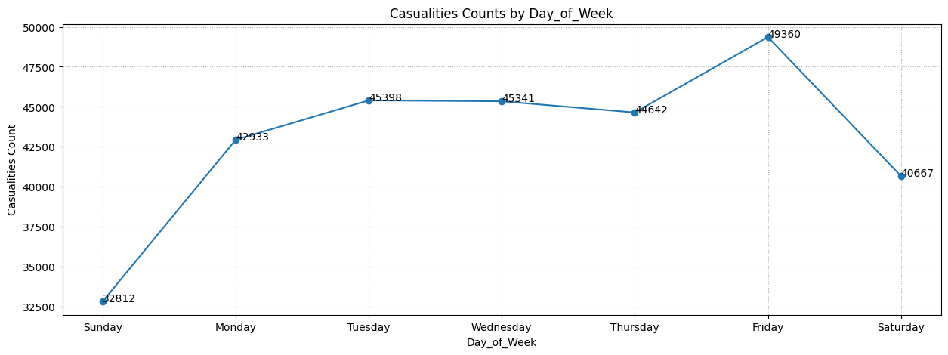
2. Which day of week show the highest number of accidents?
The most accidents was happened on Friday(50529)
Least accident was occurred in Sunday(33543)

Slide 14
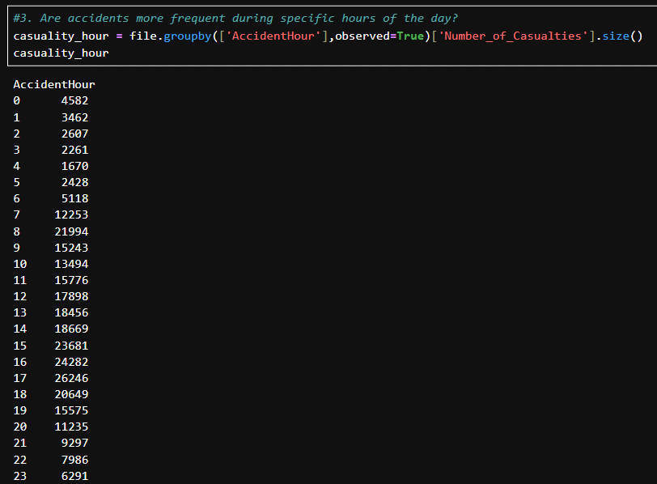
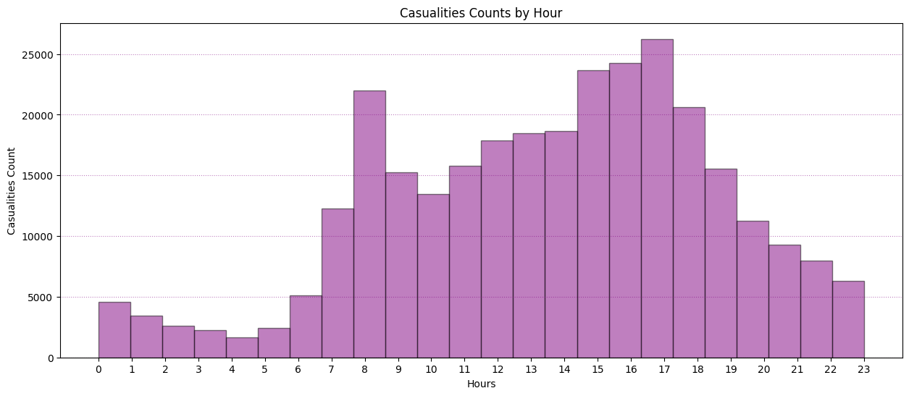
3. Are accidents more frequent during specific hours of the day?
The most accidents was happened on November(29094).
Least accident was occurred in February(21882)

Slide 15
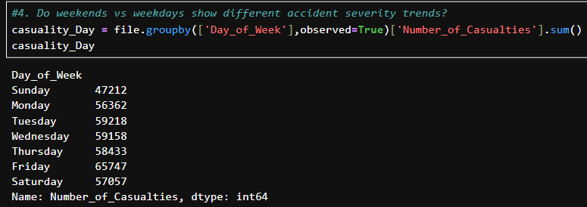
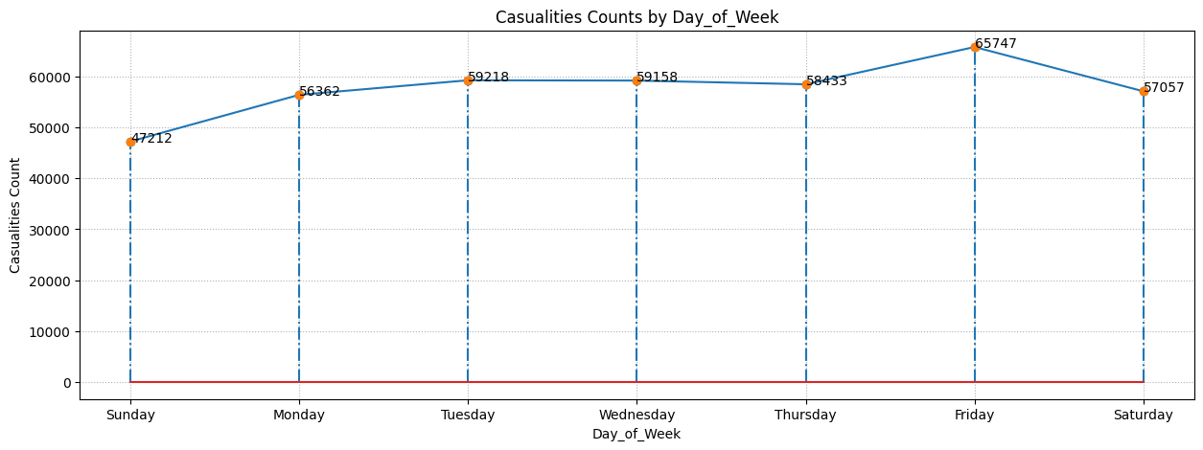
4. Do weekends vs weekdays show different accident severity trends?
Comparatively, Week days have higher count of causalities
Major accident count in the range of 50000 to 60000

Slide 16
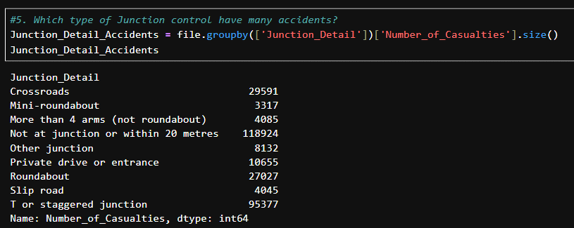
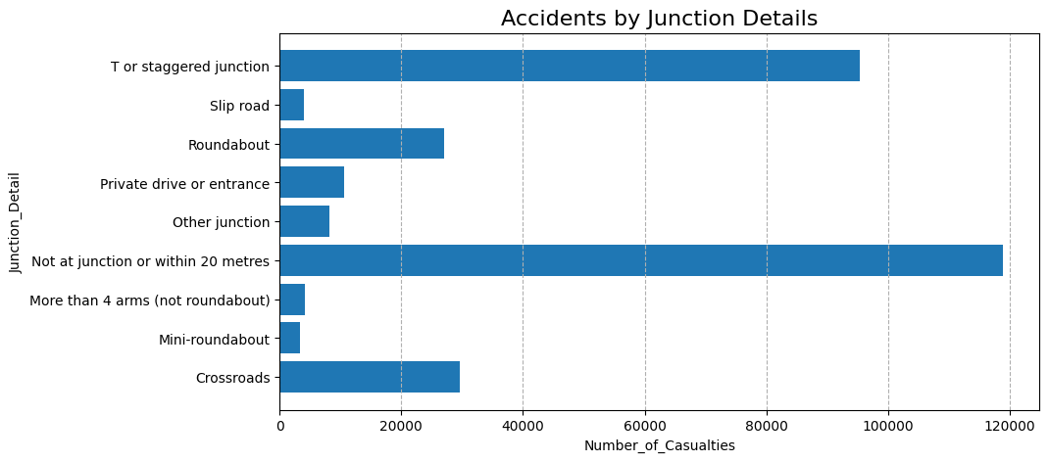
5. Which type of Junction control have many accidents?
Most of the accidents was occurred in "Not a junction or within 20 meters(11892)" and "T or staggered junction(95377)"
Least of the accidents was occurred in "Mini-roundabout(3317)" and "More than 4 arms (not roundabout)(4085)"

Slide 17
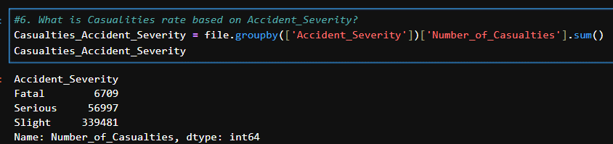
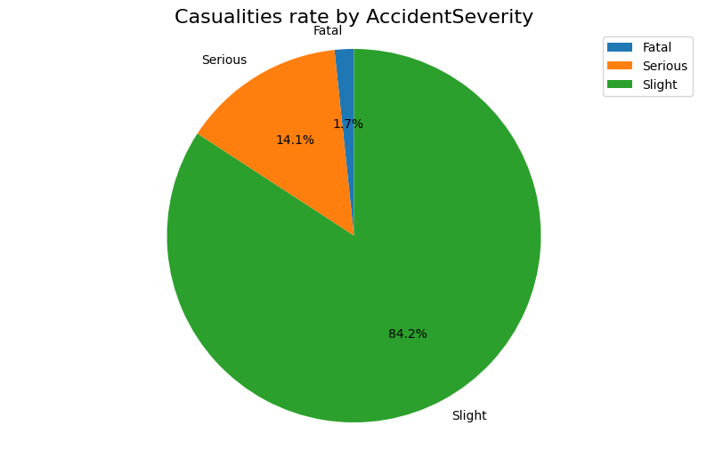
6. What is Causalities rate based on Accident_Severity?
Most of the accidents are lies under 'Slight' severity category(84.2%)
Fatal condition accidents having he rate of 1.7%
Serious condition accidents having he rate of 14.1%

Slide 18
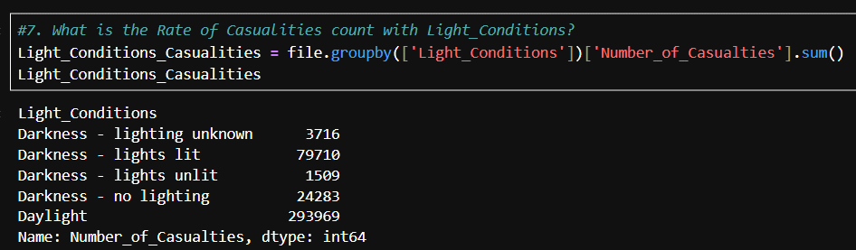
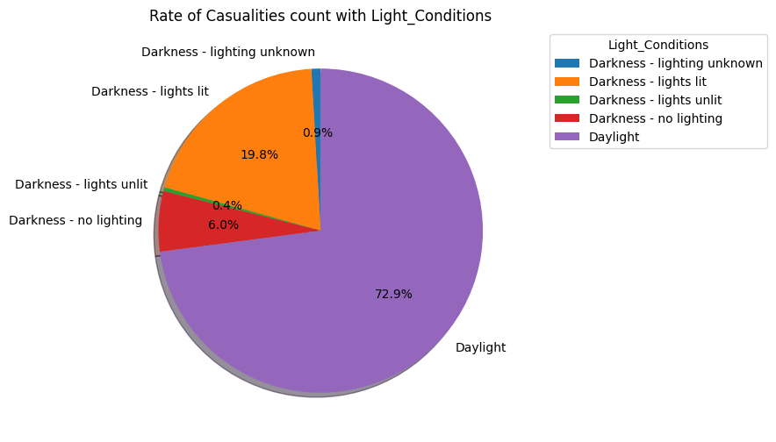
7. What is the Rate of Causalities count with Light_Conditions?
More that 70% of accidents was happened in Day lights
Around 20% of accidents was happened in Darkness with light lit
6% of accidents happened in no lighting darkness condition

Slide 19
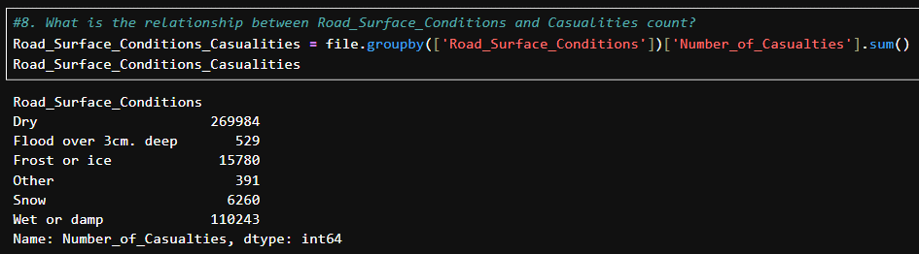
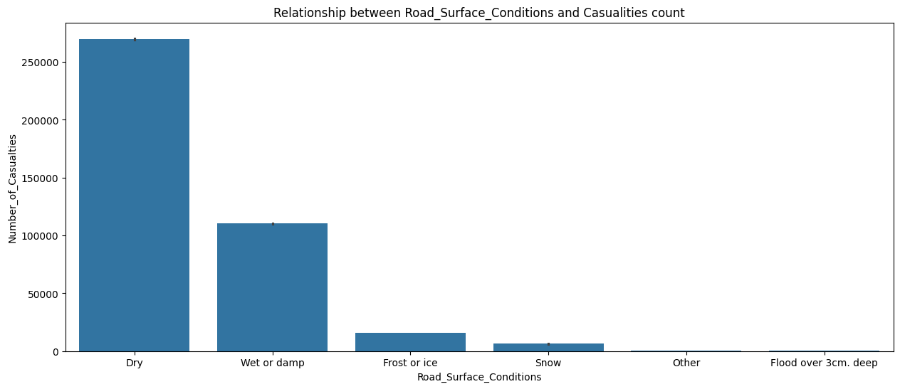
8. What is the relationship between Road_Surface_Conditions and Causalities count?
Around 2.7laks causalities were happened in Dry Road condition
Wet or Damp is the second high causalities condition
All other conditions are comparatively low

Slide 20
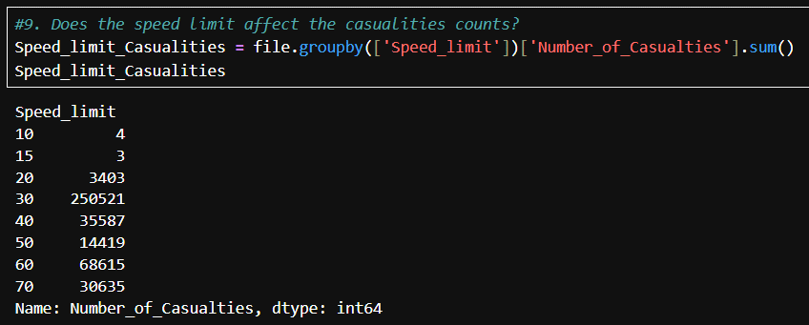
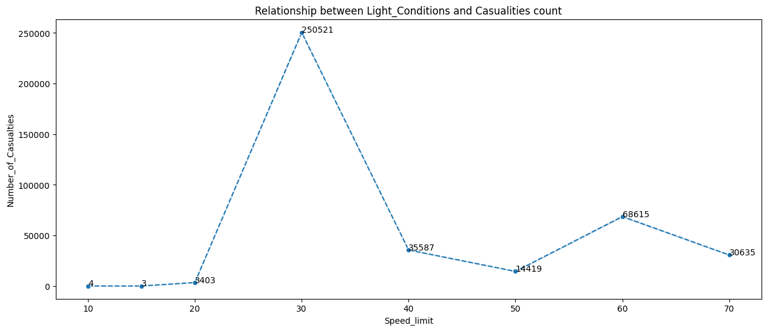
9. Does the speed limit affect the casualities counts?
We can see that around 2.5laks of Causalities happened in the 30km speed limit roads where most of the public used for transportations

Slide 21
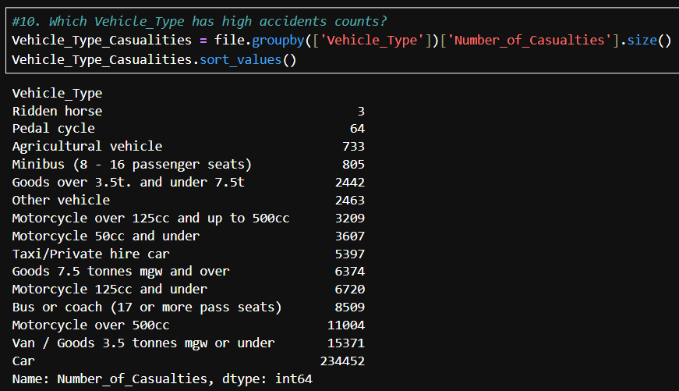
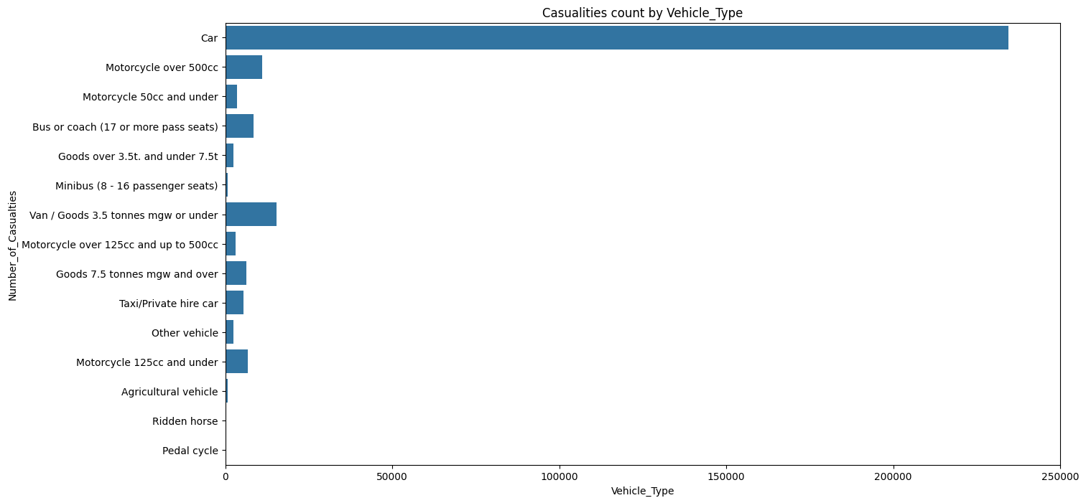
10. Which Vehicle_Type has high accidents counts?
Around 2.3 lakhs of accidents was happened with cars which the people mostly use to transport with multiple passengers and with goods.

Slide 22
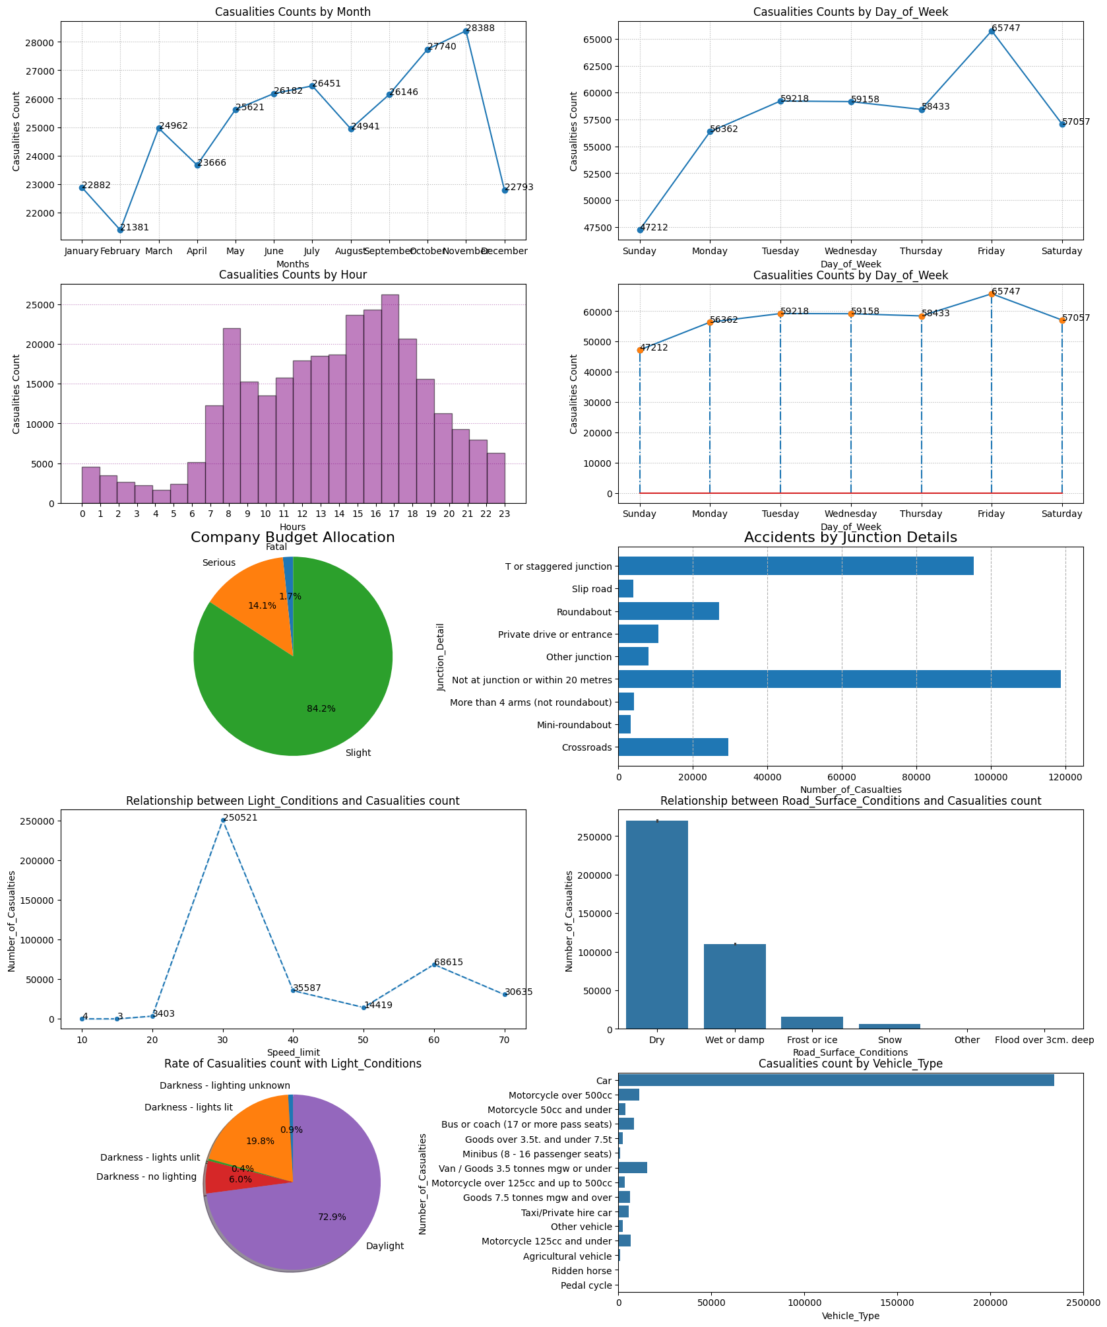
Insights
The most accidents was happened on November(29094).
Least accident was occurred in February(21882).
The most accidents was happened on Friday(50529).
Least accident was occurred in Sunday(33543).
The most accidents was happened on November(29094).
Least accident was occurred in February(21882).
Comparatively, Week days have higher count of causalities.
Major accident count in the range of 50000 to 60000.
Most of the accidents was occurred in "Not a junction or within 20 meters(11892)" and "T or staggered junction(95377)".
Least of the accidents was occurred in "Mini-roundabout(3317)" and "More than 4 arms (not roundabout)(4085)".
Most of the accidents are lies under 'Slight' severity category(84.2%).
Fatal condition accidents having he rate of 1.7%.
Serious condition accidents having he rate of 14.1%More that 70% of accidents was happened in Day lights.
Around 20% of accidents was happened in Darkness with light lit.
6% of accidents happened in no lighting darkness condition.
Around 2.7laks causalities were happened in Dry Road condition.
Wet or Damp is the second high causalities condition.
All other conditions are comparatively low.
We can see that around 2.5laks of Causalities happened in the 30km speed limit roads where most of the public used for transportations.
Around 2.3 lakhs of accidents was happened with cars which the people mostly use to transport with multiple passengers and with goods.

Slide 23
Thank You…!
Analysis by:
Loganathan R

